Slide 1
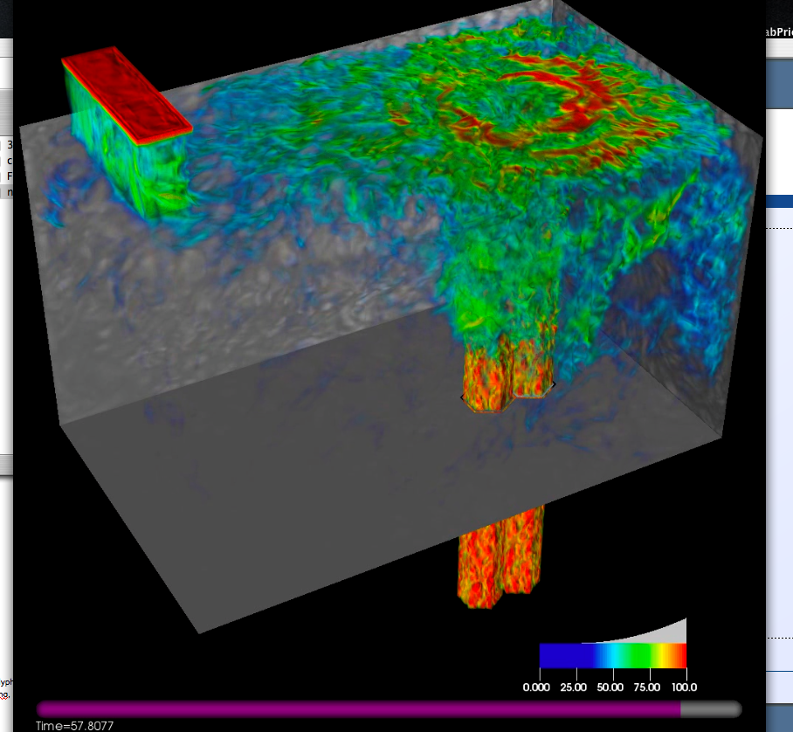
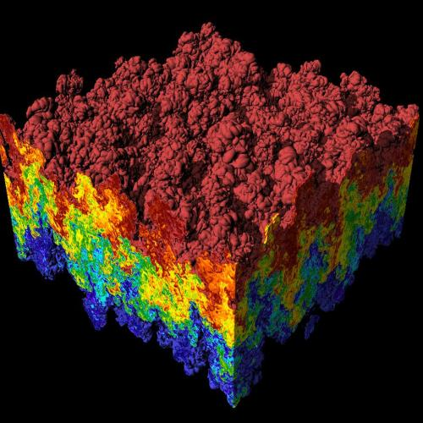
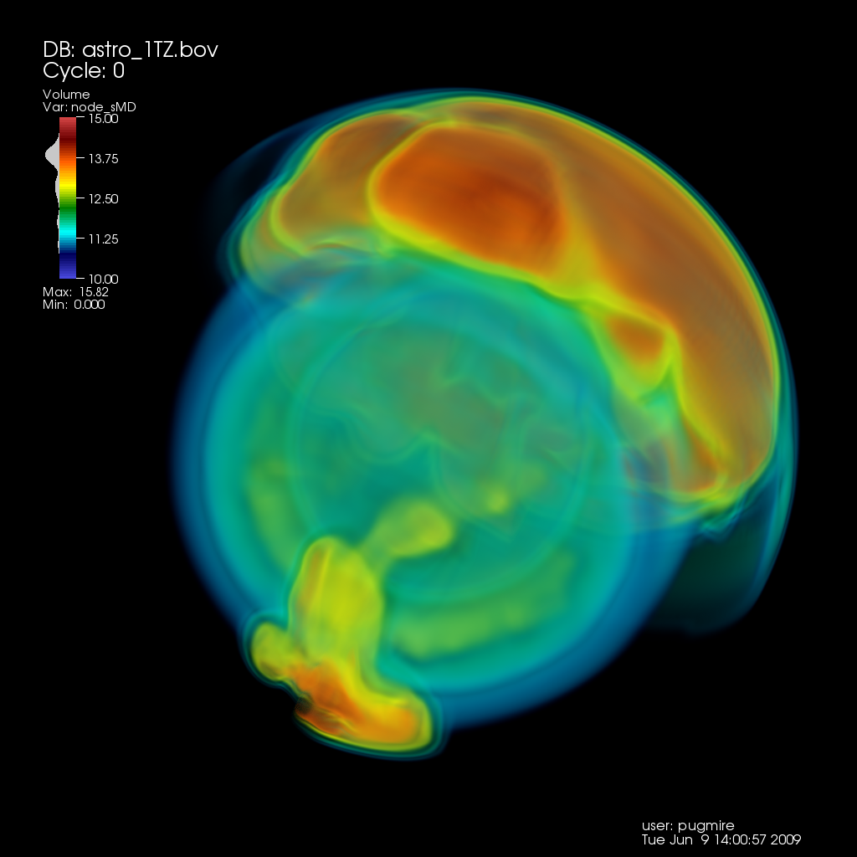
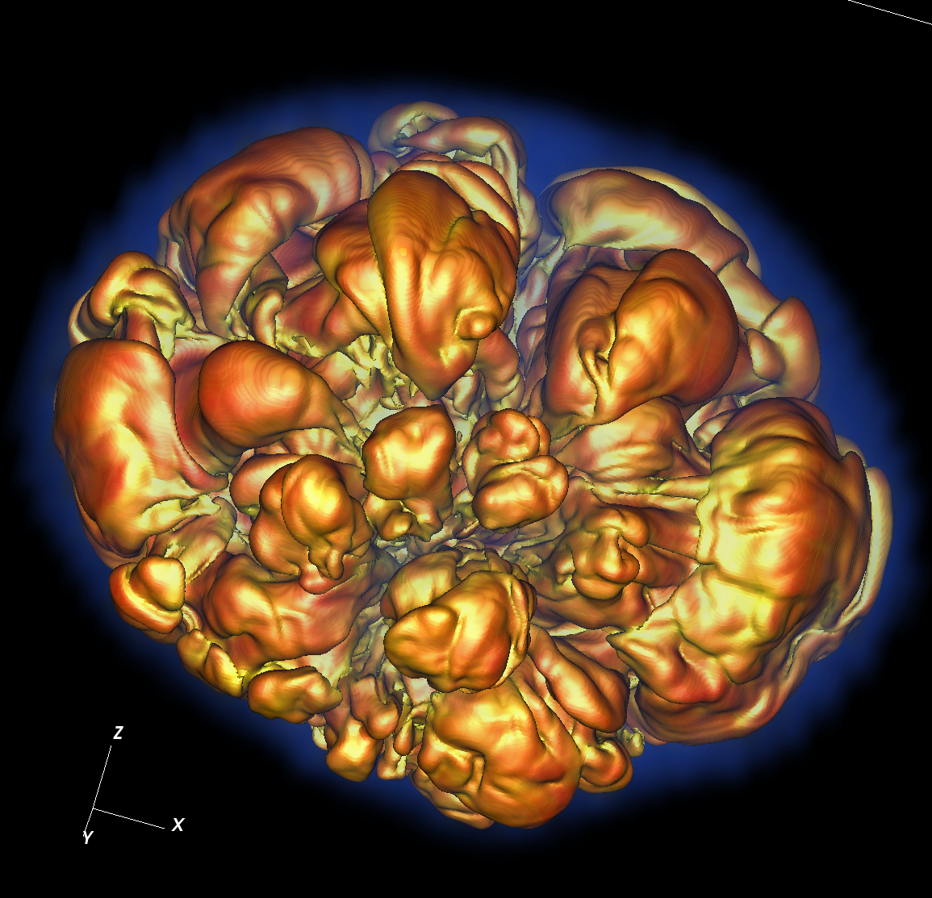
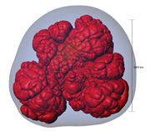
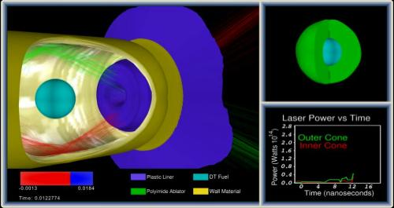
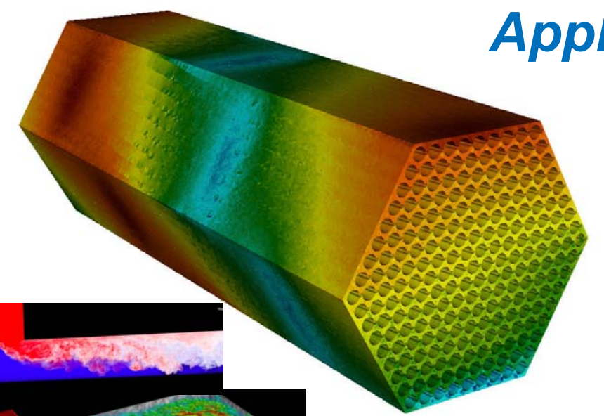
CIS 441/541: Intro to Computer Graphics Lecture 6: Transforms, pt 2
January “29,” 2019
Hank Childs, University of Oregon

Slide 2
Office Hours: Weeks 4-10
Monday: 1-2 (Roscoe)
Tuesday: 1-2 (Roscoe)
Wednesday: 1-3 (Roscoe)
Thursday: 1130-1230 (Hank)
Friday: 1130-1230 (Hank)
All normal this week!!! ☺

Slide 3
Timeline
1C: due Weds Jan 23rd
1D: assigned today (LAST TUESDAY), due Thurs Jan 31st
1E: assigned Thurs Jan 31st, due Weds Feb 6th
→ will be extra support with this. Tough project.
1F: assigned Feb 7th, due Feb 19th
→ not as tough as 1E
2A: will be assigned during week of Feb 11th
Sun | Mon | Tues | Weds | Thurs | Fri | Sat
Jan 20 | Jan21 | Jan 22 Lec4 | Jan 23 1C due | Lec 5 1D assigned | Jan 25 | Jan 26
Jan 27 | Jan 28 | Jan 29 (YouTube) | Jan 30 | Lec 6 1D due 1E assigned | Feb 1 | Feb 2
Feb 3 | Feb 4 | Feb 5 Lec 7 | Feb 6 1E due | Feb 7 1F assigned | Feb 8 | Feb 9
Likely: pre-SuperBowl OH

Slide 4
Our goal
O
O
World space:
Triangles in native Cartesian coordinates
Camera located anywhere
Camera space:
Camera located at origin, looking down -Z
Triangle coordinates relative to camera frame
z
y
x
Image space:
All viewable objects within
-1 <= x,y,z <= +1
Screen space:
All viewable objects within
-1 <= x, y <= +1
Device space:
All viewable objects within
0<=x<=width, 0 <=y<=height

Slide 5
Our goal
O
O
World space:
Triangles in native Cartesian coordinates
Camera located anywhere
Camera space:
Camera located at origin, looking down -Z
Triangle coordinates relative to camera frame
z
y
x
Image space:
All viewable objects within
-1 <= x,y,z <= +1
Screen space:
All viewable objects within
-1 <= x, y <= +1
Device space:
All viewable objects within
0<=x<=width, 0 <=y<=height

Slide 6
World Space
World Space is the space defined by the user’s coordinate system.
This space contains the portion of the scene that is transformed into camera space by the camera transform.
Many of the spaces have “bounds,” meaning limits on where the space is valid
With world space 2 options:
No bounds
User specifies the bound

Slide 7
Our goal
Camera Transform
O
O
World space:
Triangles in native Cartesian coordinates
Camera located anywhere
Camera space:
Camera located at origin, looking down -Z
Triangle coordinates relative to camera frame
z
y
x
Image space:
All viewable objects within
-1 <= x,y,z <= +1
Screen space:
All viewable objects within
-1 <= x, y <= +1
Device space:
All viewable objects within
0<=x<=width, 0 <=y<=height

Slide 8
Our goal
O
O
World space:
Triangles in native Cartesian coordinates
Camera located anywhere
Camera space:
Camera located at origin, looking down -Z
Triangle coordinates relative to camera frame
z
y
x
Image space:
All viewable objects within
-1 <= x,y,z <= +1
Screen space:
All viewable objects within
-1 <= x, y <= +1
Device space:
All viewable objects within
0<=x<=width, 0 <=y<=height

Slide 9
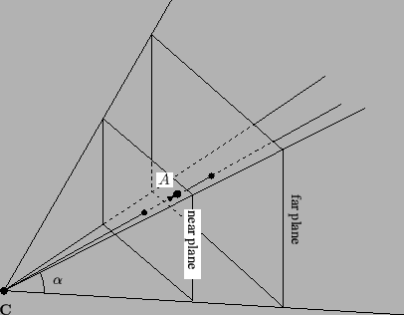
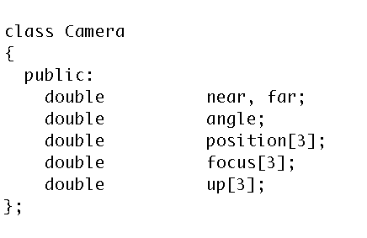
How do we specify a camera?
The “viewing pyramid” or
“view frustum”.
Frustum: In geometry, a frustum (plural: frusta or frustums) is the portion of a solid (normally a cone or pyramid) that lies between two parallel planes cutting it.

Slide 10

What is the up axis?
Up axis is the direction from the base of your nose to your forehead
Up

Slide 11
What is the up axis?
Up axis is the direction from the base of your nose to your forehead
Up
+
=

Slide 12
What is the up axis?
Up axis is the direction from the base of your nose to your forehead
(if you lie down while watching TV, the screen is sideways)
Up
+
=

Slide 13
Image Space Diagram
Up

Slide 14
Our goal
O
O
World space:
Triangles in native Cartesian coordinates
Camera located anywhere
Camera space:
Camera located at origin, looking down -Z
Triangle coordinates relative to camera frame
View Transform
z
y
x
Image space:
All viewable objects within
-1 <= x,y,z <= +1
Screen space:
All viewable objects within
-1 <= x, y <= +1
Device space:
All viewable objects within
0<=x<=width, 0 <=y<=height

Slide 15
Our goal
O
O
World space:
Triangles in native Cartesian coordinates
Camera located anywhere
Camera space:
Camera located at origin, looking down -Z
Triangle coordinates relative to camera frame
z
y
x
Image space:
All viewable objects within
-1 <= x,y,z <= +1
Screen space:
All viewable objects within
-1 <= x, y <= +1
Device space:
All viewable objects within
0<=x<=width, 0 <=y<=height

Slide 16
Image Space
Image Space is the three-dimensional coordinate system that contains screen space.
It is the space where the view transformation directs its output.
The bounds of Image Space are 3-dimensional cube.
{(x,y,z) : −1≤x≤1,−1≤y≤1, −1≤z≤1}
(or −1≤z≤0)

Slide 17
Image Space Diagram
Up
Y=1
X = -1
Z = -1
Z=1
Y = -1
X=1

Slide 18
Our goal
O
O
World space:
Triangles in native Cartesian coordinates
Camera located anywhere
Camera space:
Camera located at origin, looking down -Z
Triangle coordinates relative to camera frame
z
y
x
Image space:
All viewable objects within
-1 <= x,y,z <= +1
Screen space:
All viewable objects within
-1 <= x, y <= +1
Device space:
All viewable objects within
0<=x<=width, 0 <=y<=height

Slide 19
Screen Space
Screen Space is the intersection of the xy-plane with Image Space.
Points in image space are mapped into screen space by projecting via a parallel projection, onto the plane z = 0 .
Example:
a point (0, 0, z) in image space will project to the center of the display screen

Slide 20

Screen Space Diagram
+1
Y
-1
-1
X
+1

Slide 21
Our goal
O
O
World space:
Triangles in native Cartesian coordinates
Camera located anywhere
Camera space:
Camera located at origin, looking down -Z
Triangle coordinates relative to camera frame
z
y
x
Image space:
All viewable objects within
-1 <= x,y,z <= +1
Screen space:
All viewable objects within
-1 <= x, y <= +1
Device space:
All viewable objects within
0<=x<=width, 0 <=y<=height

Slide 22
Device Space
Device Space is the lowest level coordinate system and is the closest to the hardware coordinate systems of the device itself.
Device space is usually defined to be the n × m array of pixels that represent the area of the screen.
A coordinate system is imposed on this space by labeling the lower-left-hand corner of the array as (0,0), with each pixel having unit length and width.

Slide 23
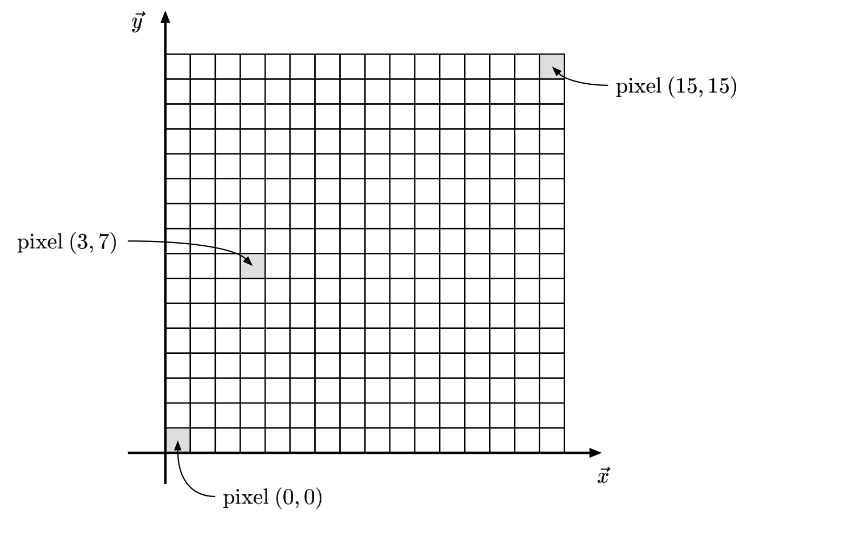
Device Space Example

Slide 24
Device Space With Depth Information
Extends Device Space to three dimensions by adding z-coordinate of image space.
Coordinates are (x, y, z) with
0 ≤ x ≤ n
0 ≤ y ≤ m
z arbitrary (but typically -1 ≤ z ≤ +1 or
-1 ≤ z ≤ 0 )

Slide 25
Start Part 2 of YouTube Video
In Part 2:
Device Space Transform
More Math Primer

Slide 26
How do we transform?
For a camera C,
Calculate Camera Frame
From Camera Frame, calculate Camera Transform
Calculate View Transform
Calculate Device Transform
Compose 3 Matrices into 1 Matrix (M)
For each triangle T, apply M to each vertex of T, then apply rasterization/zbuffer
A
C
B

Slide 27
Easiest Transform
O
O
World space:
Triangles in native Cartesian coordinates
Camera located anywhere
Camera space:
Camera located at origin, looking down -Z
Triangle coordinates relative to camera frame
z
y
x
Image space:
All viewable objects within
-1 <= x,y,z <= +1
Screen space:
All viewable objects within
-1 <= x, y <= +1
Device space:
All viewable objects within
0<=x<=width, 0 <=y<=height

Slide 28
Image Space to Device Space
(x, y, z) → ( x’, y’, z’), where
x’ = n*(x+1)/2 = nx/2 + n/2
y’ = m*(y+1)/2 = my/2 + m/2
z’ = z = z
(for an n x m image)
Matrix:
(x y z 1) (n/2 0 0 0)
x (0 m/2 0 0)
(0 0 1 0)
(n/2 m/2 0 1)

Slide 29
More Math Prep
Note: Ken Joy’s graphics notes are fantastic
http://www.idav.ucdavis.edu/education/GraphicsNotes/homepage.html

Slide 30
What is the norm of a vector?
The norm of a vector is its length
Denoted with || . ||
For a vector A = (A.x, A.y),
||A|| = sqrt(A.x*A.x+A.y*A.y)
Physical interpretation:
For 3D, ||A|| = sqrt(A.x*A.x+A.y*A.y+A.z*A.z)
(A.x,A.y)
||A||
y
x

Slide 31
What does it means for a vector to be normalized?
The vector A is normalized if ||A|| = 1.
This is also called a unit vector.
To obtain a normalized vector, take A/||A||
Many of the operations we will discuss today will only work correctly with normalized vectors.

Slide 32
What is a dot product?
A.B = A.x*B.x + A.y*B.y
(or A.x*B.x + A.y*B.y + A.z*B.z)
Physical interpretation:
A.B = cos(α)*(||A||*||B||)
B = (B.x, B.y)
A = (A.x,A.y)
α

Slide 33
What is the cross product?
AxB = (A.y*B.z - A.z*B.y,
B.x*A.z - A.x*B.z,
A.x*B.y - A.y*B.x)
What is the physical interpretation of a cross product?
Finds a vector perpendicular to both A and B.

Slide 34
Homogeneous Coordinates
Defined: a system of coordinates used in projective geometry, as Cartesian coordinates are used in Euclidean geometry
Primary uses:
4 × 4 matrices to represent general 3-dimensional transformations
it allows a simplified representation of mathematical functions – the rational form – in which rational polynomial functions can be simply represented
We only care about the first
I don’t really even know what the second use means

Slide 35
Interpretation of Homogeneous Coordinates
4D points: (x, y, z, w)
Our typical frame: (x, y, z, 1)

Slide 36
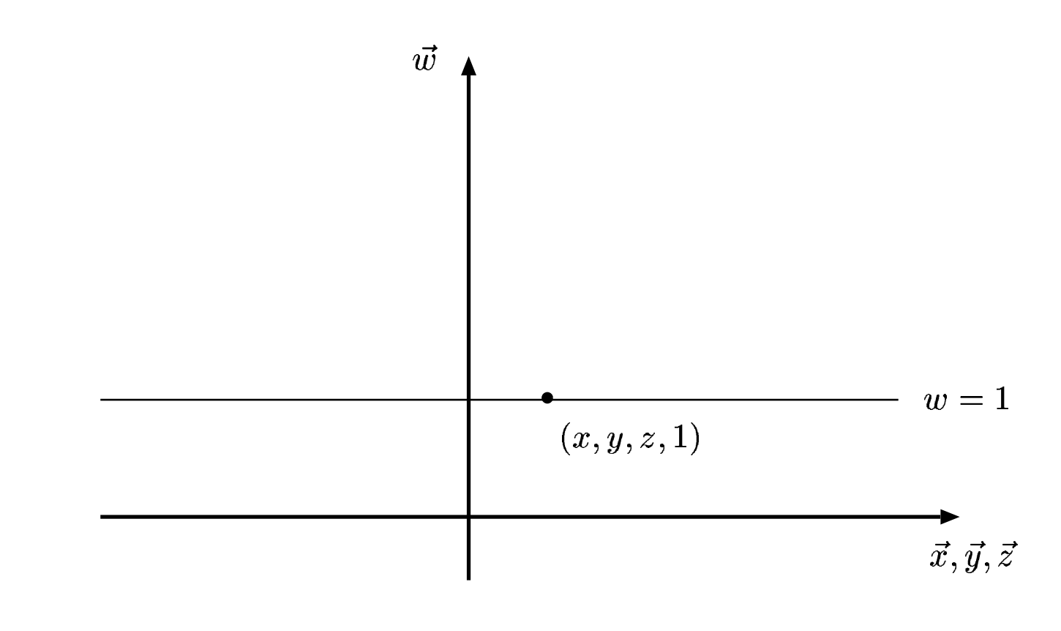
Interpretation of Homogeneous Coordinates
4D points: (x, y, z, w)
Our typical frame: (x, y, z, 1)
So how to treat points not along the w=1 line?
Our typical frame in the context of 4D points

Slide 37
Projecting back to w=1 line
Let P = (x, y, z, w) be a 4D point with w != 1
Goal: find P’ = (x’, y’, z’, 1) such P projects to P’
(We have to define what it means to project)
Idea for projection:
Draw line from P to origin.
If Q is along that line (and Q.w == 1), then Q is a projection of P

Slide 38
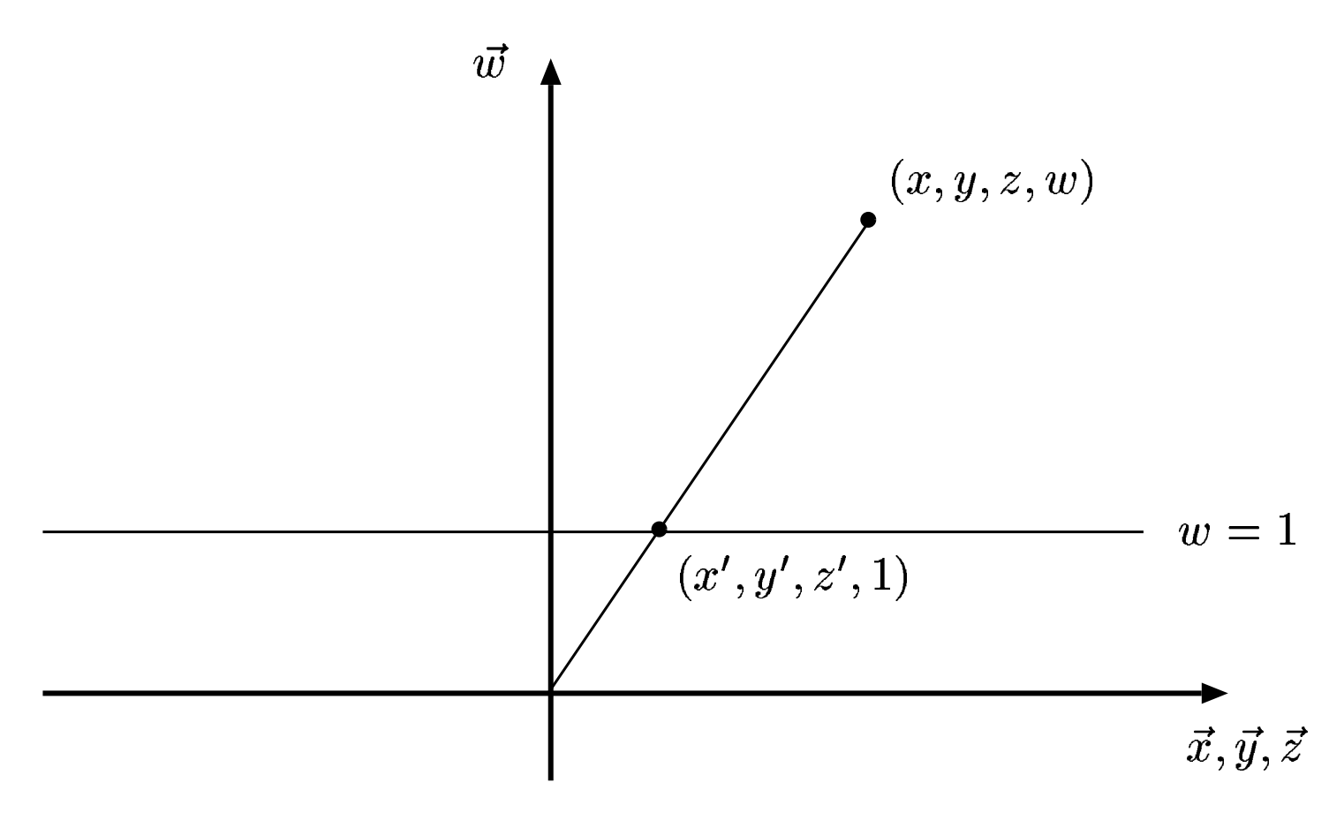
Projecting back to w==1 line
Idea for projection:
Draw line from P to origin.
If Q is along that line (and Q.w == 1), then Q is a projection of P
Notes:
Projection

Slide 39
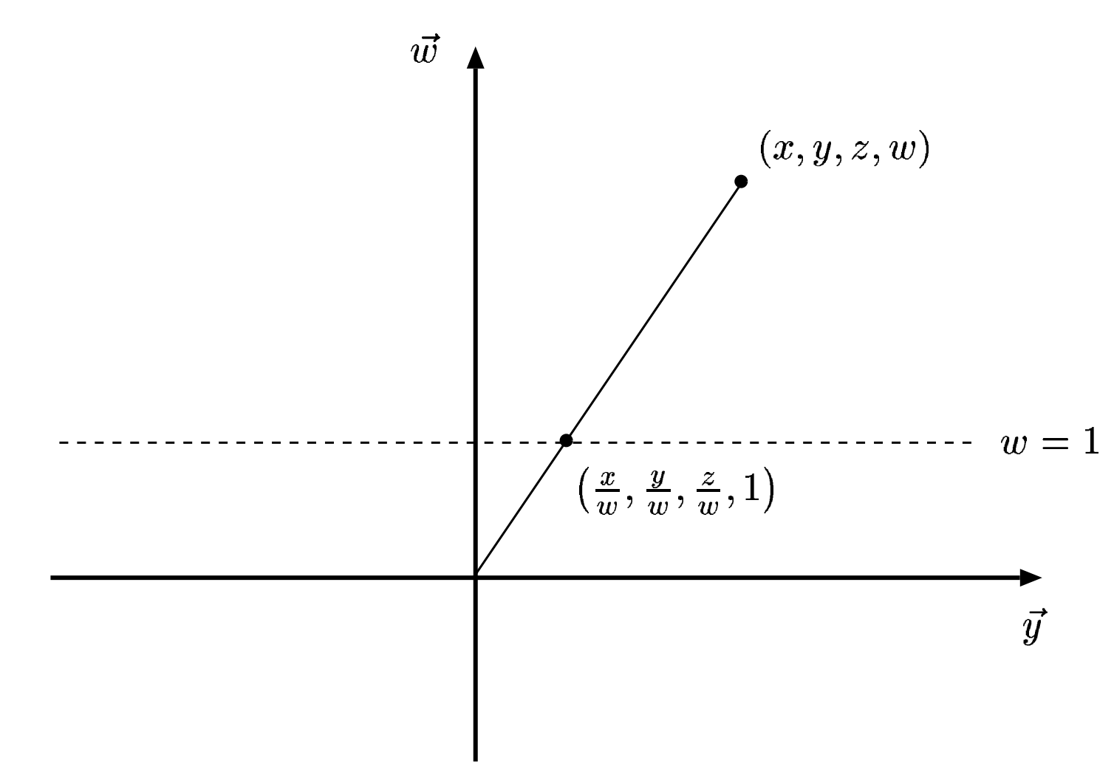
So what is Q?
Similar triangles argument:
x’ = x/w
y’ = y/w
z’ = z/w

Slide 40
Our goal
O
O
-Z
World space:
Triangles in native Cartesian coordinates
Camera located anywhere
Camera space:
Camera located at origin, looking down -Z
Triangle coordinates relative to camera frame
Need to construct a Camera Frame
Need to construct a matrix to transform points from Cartesian Frame to Camera Frame
Transform triangle by transforming its three vertices

Slide 41
Basis pt 2 (more linear algebra-y this time)
Camera frame must be a basis:
Spans space … can get any point through a linear combination of basis vectors
Every member must be linearly independent
→ we didn’t talk about this much on Thursday.
linearly independent means that no basis vector can be represented via others
Repeat slide (coming up) shows linearly *dependent* vectors

Slide 42
(REPEAT) Why unique?
Let (a, b, c) mean:
The number of steps ‘a’ in direction D1
The number of steps ‘b’ in direction D2
The number of steps ‘c’ in direction D3
Then there is more than one way to get to some point X in S, i.e.,
(a1, b1, c1) = X and
(a2, b2, c2) = X
D1
D3
D2

Slide 43
Camera frame construction
Must choose (u,v,w,O)
O = camera position
w = O-focus
Not “focus-O”, since we want to look down -Z
O
-Z
Camera space:
Camera located at origin, looking down -Z
Triangle coordinates relative to camera frame

Slide 44
Camera frame construction
Must choose (u,v,w,O)
O = camera position
w = O-focus
v = up
u = up x (O-focus)
O
-Z
Camera space:
Camera located at origin, looking down -Z
Triangle coordinates relative to camera frame
v1
V2…
w
u
Notes:
U perpendicular to V
U perpendicular to W
Don’t know whether V perpendicular to W

Slide 45
But wait … what if dot(v2,v3) != 0?
Up
O-focus
We can get around this with two cross products:
u = Up x (O-focus)
v = (O-focus) x u

Slide 46
Camera frame summarized
O = camera position
u = Up x (O-focus)
v = (O-focus) x u
w = O-focus
Important note: u, v, and w need to be normalized!
Notes:
O is “position” double position[3];

Slide 47
Our goal
O
O
-Z
World space:
Triangles in native Cartesian coordinates
Camera located anywhere
Camera space:
Camera located at origin, looking down -Z
Triangle coordinates relative to camera frame
Need to construct a Camera Frame ← ✔
Need to construct a matrix to transform points from Cartesian Frame to Camera Frame
Transform triangle by transforming its three vertices

Slide 48
This Will Come Up Later
Consider the meaning of Cartesian coordinates (x,y,z):
[x y z 1][<1,0,0>]
[<0,1,0>] = (x,y,z)
[<0,0,1>]
[(0,0,0)]

Slide 49
The Two Frames of the Camera Transform
Our two frames:
Cartesian:
<1,0,0>
<0,1,0>
<0,0,1>
(0,0,0)
Camera:
u = up x (O-focus)
v = (O-focus) x u
w = (O-focus)
O

Slide 50
The Two Frames of the Camera Transform
Our two frames:
Cartesian:
<1,0,0>
<0,1,0>
<0,0,1>
(0,0,0)
Camera:
u = up x (O-focus)
v = (O-focus) x u
w = (O-focus)
O
The “Camera Frame” is a Frame, so we can express any Cartesian vector as a combination of u, v, w.

Slide 51
Converting From Cartesian Frame To Camera Frame
The Cartesian vector <1,0,0> can be represented as some combination of the Camera Frame’s basis functions u, v, w:
<1,0,0> = e1,1 * u + e1,2 * v + e1,3 * w
So can the Cartesian vector <0,1,0>
<0,1,0> = e2,1 * u + e2,2 * v + e2,3 * w
So can the Cartesian vector <0,0,1>
<0,0,1> = e3,1 * u + e3,2 * v + e3,3 * w
So can the vector: Cartesian Frame origin – Camera Frame origin
(0,0,0) - O = e4,1 * u + e4,2 * v + e4,3 * w →
(0,0,0) = e4,1 * u + e4,2 * v + e4,3 * w + O

Slide 52
Putting Our Equations Into Matrix Form
<1,0,0> = e1,1 * u + e1,2 * v + e1,3 * w
<0,1,0> = e2,1 * u + e2,2 * v + e2,3 * w
<0,0,1> = e3,1 * u + e3,2 * v + e3,3 * w
(0,0,0) = e4,1 * u + e4,2 * v + e4,3 * w + O
→
[<1,0,0>] [e1,1 e1,2 e1,3 0] [u]
[<0,1,0>] [e2,1 e2,2 e2,3 0] [v]
[<0,0,1>] = [e3,1 e3,2 e3,3 0] [w]
(0,0,0) [e4,1 e4,2 e4,3 1] [O]

Slide 53
Here Comes The Trick…
Consider the meaning of Cartesian coordinates (x,y,z):
[x y z 1][<1,0,0>]
[<0,1,0>] = (x,y,z)
[<0,0,1>]
[(0,0,0)]
But:
[<1,0,0>] [e1,1 e1,2 e1,3 0] [u]
[<0,1,0>] [e2,1 e2,2 e2,3 0] [v]
[<0,0,1>] = [e3,1 e3,2 e3,3 0] [w]
(0,0,0) [e4,1 e4,2 e4,3 1] [O]

Slide 54
Here Comes The Trick…
But:
[<1,0,0>] [e1,1 e1,2 e1,3 0] [u]
[x y z 1][<0,1,0>] [x y z 1] [e2,1 e2,2 e2,3 0] [v]
[<0,0,1>] = [e3,1 e3,2 e3,3 0] [w]
[(0,0,0)] [e4,1 e4,2 e4,3 1] [O]
Coordinates of (x,y,z) with respect
to Cartesian frame.
Coordinates of (x,y,z) with respect
to Camera frame.
So this matrix is the camera transform!!

Slide 55
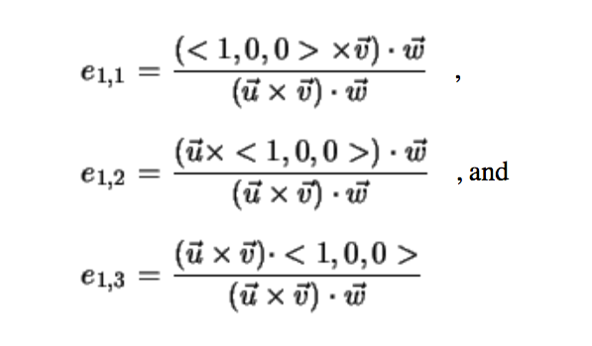
And Cramer’s Rule Can Solve This, For Example…
(u == v1, v == v2, w == v3 from previous slide)

Slide 56
Solving the Camera Transform
[e1,1 e1,2 e1,3 0] [u.x v.x w.x 0]
[e2,1 e2,2 e2,3 0] [u.y v.y w.y 0]
[e3,1 e3,2 e3,3 0] = [u.z v.z w.z 0]
[e4,1 e4,2 e4,3 1] [u.t v.t w.t 1]
Where t = (0,0,0)-O
How do we know?: Cramer’s Rule + simplifications
Want to derive?:
http://www.idav.ucdavis.edu/education/ GraphicsNotes/Camera-Transform/Camera- Transform.html
Notes:
u.t: dot product of u and t.
First three rows are u’x,y,z. The last one is the dot product

Slide 57
Our goal
O
O
World space:
Triangles in native Cartesian coordinates
Camera located anywhere
Camera space:
Camera located at origin, looking down -Z
Triangle coordinates relative to camera frame
View Transform
z
y
x
Image space:
All viewable objects within
-1 <= x,y,z <= +1
Screen space:
All viewable objects within
-1 <= x, y <= +1
Device space:
All viewable objects within
0<=x<=width, 0 <=y<=height

Slide 58
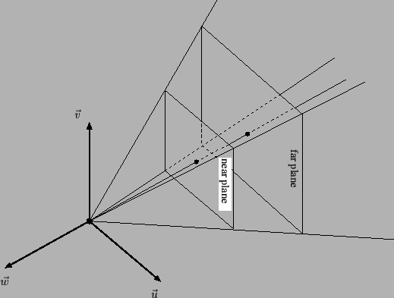
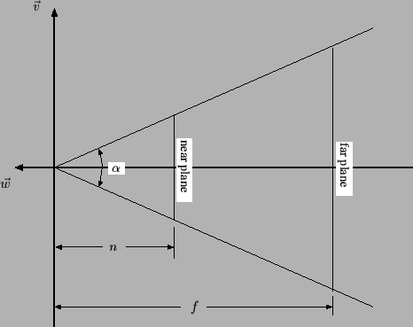

Slide 59
View Transformation
v = +1
v = -1
w = +1
w = -1
The viewing transformation is not a combination of simple translations, rotations, scales or shears: it is more complex.

Slide 60
Derivation of Viewing Transformation
I personally don’t think it is a good use of class time to derive this matrix.
Well derived at:
http://www.idav.ucdavis.edu/education/GraphicsNotes/Viewing-Transformation/Viewing-Transformation.html

Slide 61
The View Transformation
Input parameters: (α, n, f)
Transforms view frustum to image space cube
View frustum: bounded by viewing pyramid and planes z=-n and z=-f
Image space cube: -1 <= u,v,w <= 1
Cotangent = 1/tangent
[cot(α/2) 0 0 0]
[0 cot(α/2) 0 0]
[0 0 (f+n)/(f-n) -1]
[0 0 2fn/(f-n) 0]
Notes:
α: degree, in radius
N, near
F: far side

Slide 62
Let’s do an example
Input parameters: (α, n, f) = (90, 5, 10)
f=10
n=5
α=90
[cot(α/2) 0 0 0]
[0 cot(α/2) 0 0]
[0 0 (f+n)/(f-n) -1]
[0 0 2fn/(f-n) 0]

Slide 63
Let’s do an example
Input parameters: (α, n, f) = (90, 5, 10)
f=10
n=5
α=90
[1 0 0 0]
[0 1 0 0]
[0 0 3 -1]
[0 0 20 0]

Slide 64
Let’s do an example
Input parameters: (α, n, f) = (90, 5, 10)
f=10
n=5
α=90
[1 0 0 0]
[0 1 0 0]
[0 0 3 -1]
[0 0 20 0]
Let’s multiply some points:
(0,7,-6,1)
(0,7,-8,1)

Slide 65
Let’s do an example
Input parameters: (α, n, f) = (90, 5, 10)
f=10
n=5
α=90
[1 0 0 0]
[0 1 0 0]
[0 0 3 -1]
[0 0 20 0]
Let’s multiply some points:
(0,7,-6,1) = (0,7,2,6) = (0, 1.16, 0.33)
(0,7,-8,1) = (0,7,-4,8) = (0, 0.88, -0.5)
Notes:
(0,7,2,6) => project back = (a/d,b/d,c/d) = (0/6, 7/6, 2/6)
(a,b,c,d)

Slide 66
Let’s do an example
Input parameters: (α, n, f) = (90, 5, 10)
f=10
n=5
α=90
[1 0 0 0]
[0 1 0 0]
[0 0 3 -1]
[0 0 20 0]
More points:
(0,7,-4,1) = (0,7,8,4) = (0, 1.75, 2)
(0,7,-5,1) = (0,7,5,5) = (0, 1.4, 1)
(0,7,-6,1) = (0,7,2,6) = (0, 1.16, 0.33)
(0,7,-8,1) = (0,7,-4,8) = (0, 0.88, -0.5)
(0,7,-10,1) = (0,7,-10,10) = (0, 0.7, -1)
(0,7,-11,1) = (0,7,-13,11) = (0, .63, -1.18)

Slide 67
View Transformation
v = +1
v = -1
w = +1
w = -1
The viewing transformation is not a combination of simple translations, rotations, scales or shears: it is more complex.

Slide 68
View Transformation
(0,1.75, 2)
(0,1.4, 1)
(0,1.16, 0.33)
v = +1
(0,0.88,-0.5)
(0,0.7,-1)
(0,0.63,-1.18)
v = -1
More points:
(0,7,-4,1) = (0,7,8,4) = (0, 1.75, 2)
(0,7,-5,1) = (0,7,5,5) = (0, 1.4, 1)
(0,7,-6,1) = (0,7,2,6) = (0, 1.16, 0.33)
(0,7,-8,1) = (0,7,-4,8) = (0, 0.88, -0.5)
(0,7,-10,1) = (0,7,-10,10) = (0, 0.7, -1)
(0,7,-11,1) = (0,7,-13,11) = (0, .63, -1.18)
w = +1
w = -1
Note there is a non-linear relationship in W (“Z”).

Slide 69
Putting It All Together

Slide 70
How do we transform?
For a camera C,
Calculate Camera Frame
From Camera Frame, calculate Camera Transform
Calculate View Transform
Calculate Device Transform
Compose 3 Matrices into 1 Matrix (M)
For each triangle T, apply M to each vertex of T, then apply rasterization/zbuffer

Slide 71
Project 1E

Slide 72
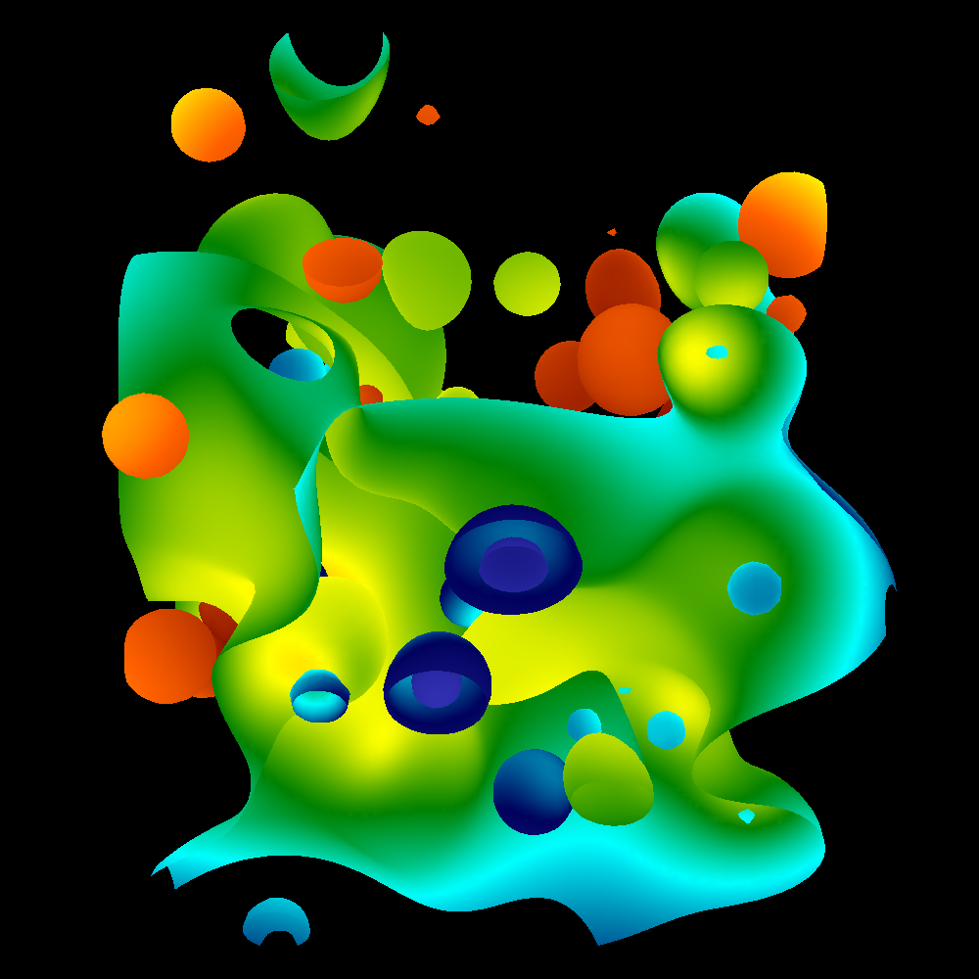
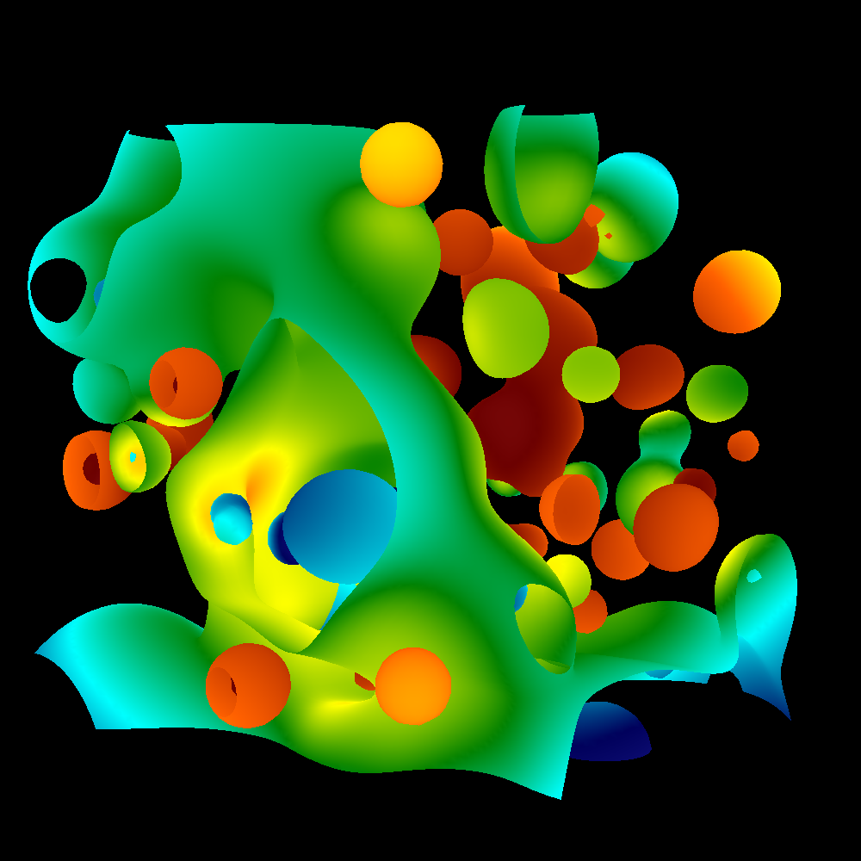

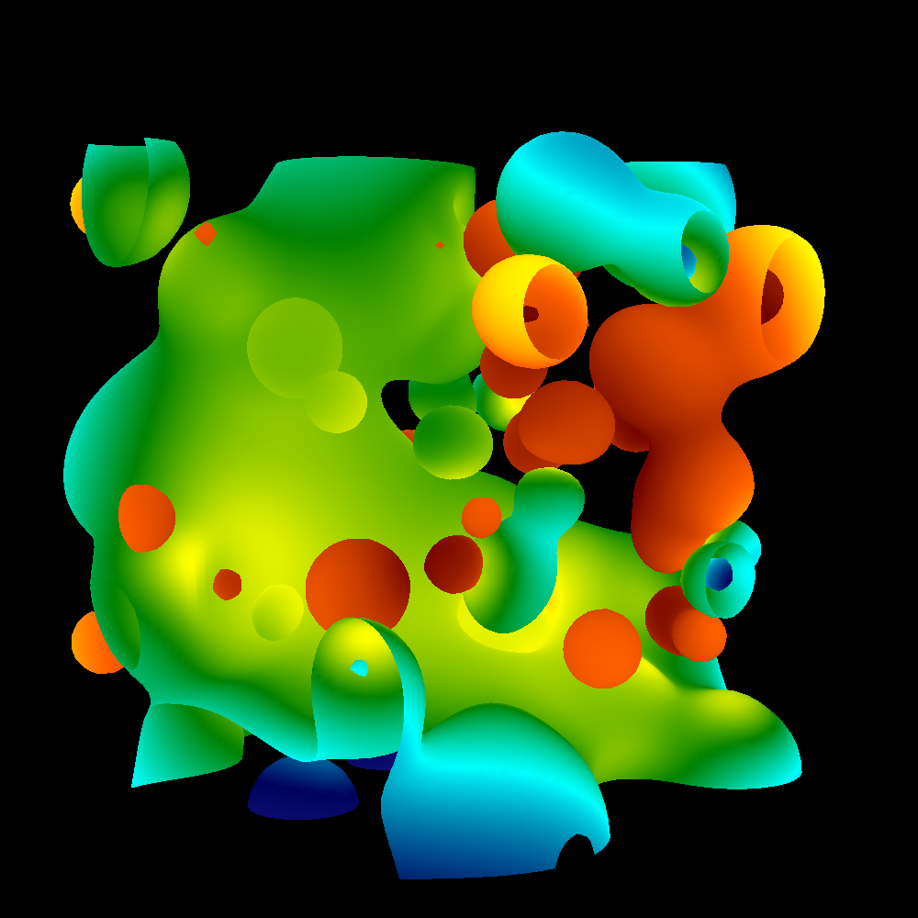
Project #1E (6%), Due Weds Feb 6th
Goal: add arbitrary camera positions
Extend your project1D code
New: proj1e_geometry.vtk available on web (9MB), “reader1e.cxx”.
New: Matrix.cxx, Camera.cxx
No Cmake, project1E.cxx

Slide 73
Project #1E, expanded
Matrix.cxx: complete
Methods:
class Matrix
{
public:
double A[4][4];
void TransformPoint(const double *ptIn, double *ptOut);
static Matrix ComposeMatrices(const Matrix &, const Matrix &);
void Print(ostream &o);
};

Slide 74
Project #1E, expanded
Camera.cxx: you work on this
class Camera
{
public:
double near, far;
double angle;
double position[3];
double focus[3];
double up[3];
Matrix ViewTransform(void) {;};
Matrix CameraTransform(void) {;};
Matrix DeviceTransform(void) {;};
// Will probably need something for calculating Camera Frame as well
};
Also: GetCamera(int frame, int nFrames)

Slide 75
Project #1E, deliverables
Same as usual, but times 4
4 images, corresponding to
GetCamera(0, 1000)
GetCamera(250,1000)
GetCamera(500,1000)
GetCamera(750,1000)
If you want:
Generate all thousand images, make a movie
Then you should wait for 1F. Then we will have shading too.

Slide 76
Project #1E, game plan
vector<Triangle> t = GetTriangles();
AllocateScreen();
for (int i = 0 ; i < 4 ; i++)
{ int f = 250*i;
InitializeScreen();
Camera c = GetCamera(f, 1000);
TransformTrianglesToDeviceSpace(); // involves setting up and applying matrices
//… if you modify vector<Triangle> t,
// remember to undo it later
RenderTriangles();
SaveImage();
}

Slide 77
Correct answers given for GetCamera(0, 1000)
Camera Frame: U = 0, 0.707107, -0.707107
Camera Frame: V = -0.816497, 0.408248, 0.408248
Camera Frame: W = 0.57735, 0.57735, 0.57735
Camera Frame: O = 40, 40, 40
Camera Transform
(0.0000000 -0.8164966 0.5773503 0.0000000)
(0.7071068 0.4082483 0.5773503 0.0000000)
(-0.7071068 0.4082483 0.5773503 0.0000000)
(0.0000000 0.0000000 -69.2820323 1.0000000)
View Transform
(3.7320508 0.0000000 0.0000000 0.0000000)
(0.0000000 3.7320508 0.0000000 0.0000000)
(0.0000000 0.0000000 1.0512821 -1.0000000)
(0.0000000 0.0000000 10.2564103 0.0000000)
Transformed 37.1132, 37.1132,37.1132, 1 to 0, 0,1
Transformed -75.4701, -75.4701,-75.4701, 1 to 0, 0,-1

Slide 78
Project #1E pitfalls
All vertex multiplications use 4D points. Make sure you send in 4D points for input and output, or you will get weird memory errors.
Make sure you divide by w.

Slide 79
Project #1E, pitfalls
People often get a matrix confused with its transpose. Use the method Matrix::Print() to make sure the matrix you are setting up is what you think it should be. Also, remember the points are left multiplied, not right multiplied.
Regarding multiple renderings:
Don’t forget to initialize the screen between each render
If you modify the triangle in place to render, don’t forget to switch it back at the end of the render

Slide 80
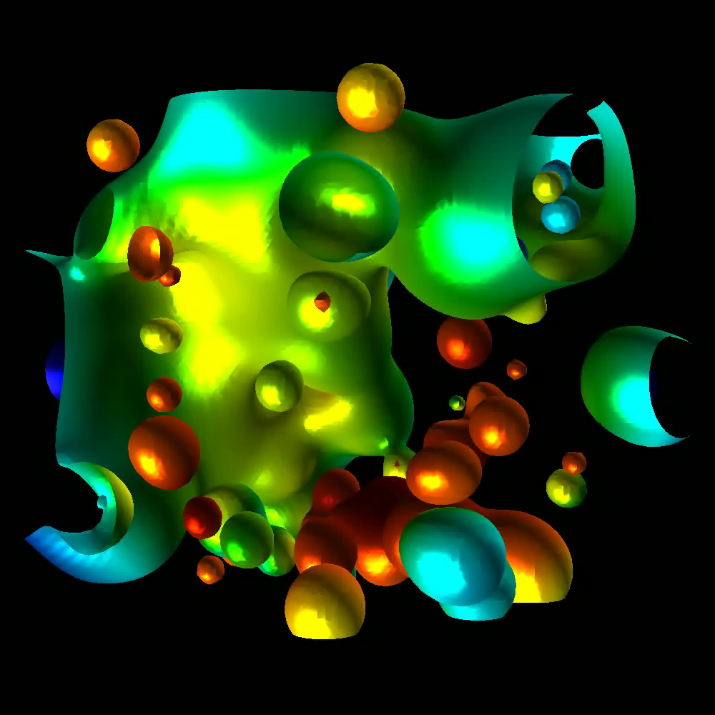
Project #1F (8%), Due Feb 19th
Goal: add shading, movie

